Slide 1



Exploring Arbia’s life
Self presentation

Slide 2

Introduction
My name is Arbia Sohail. The girl with lots of dreams and future goals. Studying in class 9 and I live in Karachi. I enjoy learning new things, especially in my computer course, and I always try to do my best in studies. In this presentation, I will share about my personality, hobbies, achievements, skills, and future goals.

Slide 3
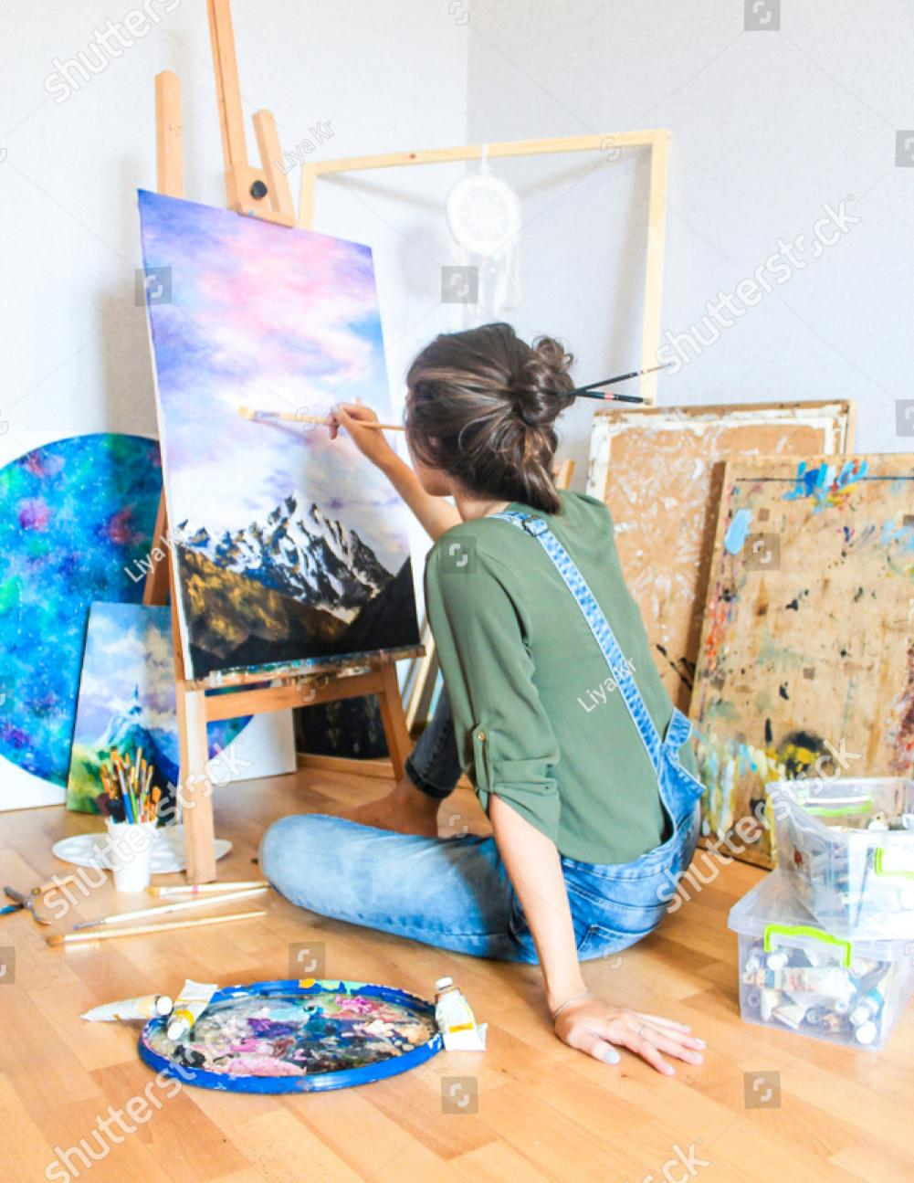
Personality traits and hobbies
Personality traits | Hobbies and interests
Creative | Reading books
Hard working | Drawing
Positive thinking | Listening to music

Slide 4

Achievements and skills (through CIT)
ACHIEVEMENTS:
One of my biggest achievements is getting good marks in my exams and taking part in different school activities. I am proud of the effort I put into my studies and projects.
Skills through CIT:
In my CIT course, I have learned many useful skills such as working with MS Word, creating presentations in PowerPoint, and get knowledge about networking. These skills are very helpful for my studies and will also benefit me in my future career. They have made me more confident in using technology.

Slide 5
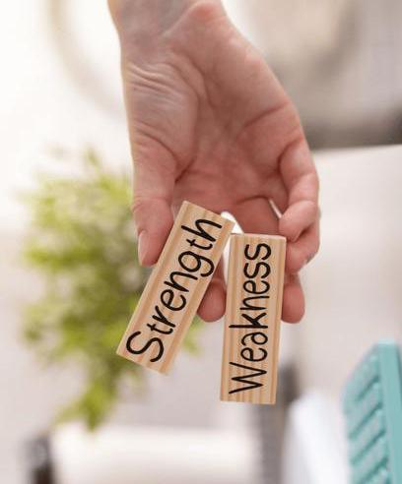
My tools and talents
Favourite tool | Strength | Weakness
Mobile phone | Confident speaker | Taking extra time
PowerPoint | Quick learner | Avoid medicines

Slide 6
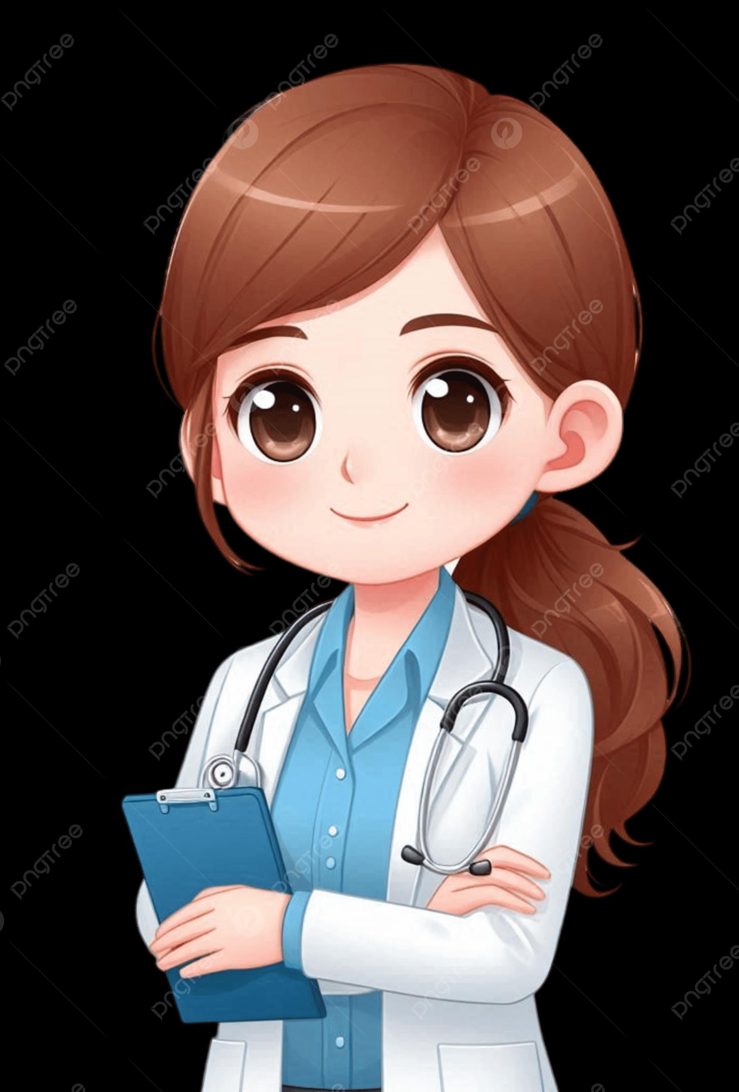
Future goals and inspiration
Future goals:
My future goals are to improve my computer and communication skills so that I can do my work more efficiently. In the long term, I want to become a successful Doctor . I believe that working hard and learning new things every day will help me reach my dreams
Inspired by:
My role models are my parents because they always guide me and work hard for our family. Their dedication and support inspire me to stay focused, work hard, and always try to do my best in everything I do

Slide 7

Ending and something fun
Thank you for listening to my presentation. I hope you enjoyed learning about me. A fun fact about me is that I can stay awake all night if I’m reading an interesting book or working on a project I love. I enjoy discovering new things and always try to make learning fun and exciting
Thank you for your time and cooperation.

